Slide 1
nouns
Person, Place, Thing or Idea

Slide 2
What is a noun?
Noun – a person, place, thing or idea
Common Noun – any noun that represents one or all of the members of a class
Examples: dog, cat, man, woman, education
Proper Noun – a noun that is the name of a specific person, place or thing
Examples: Susan, Charlie, Orlando, Walmart, Coca Cola

Slide 3
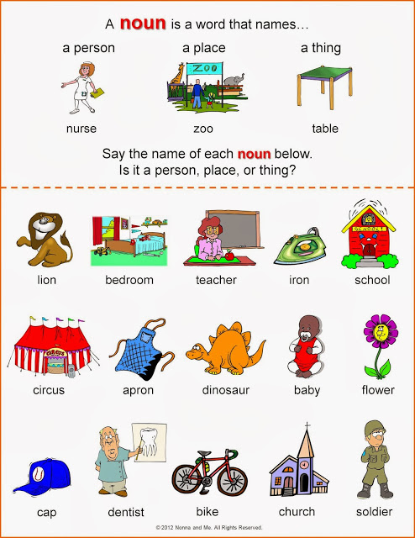

Slide 4
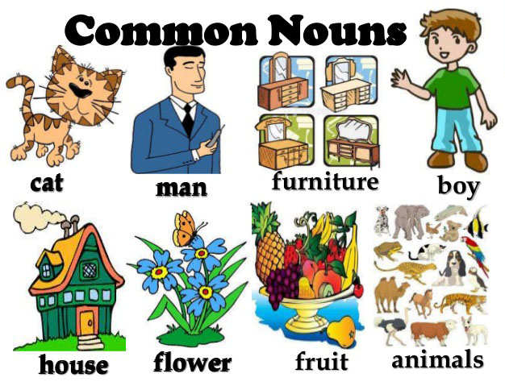

Slide 5
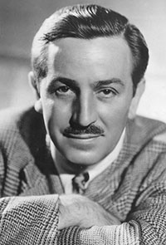
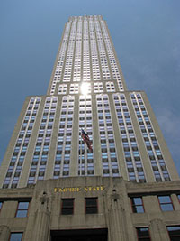
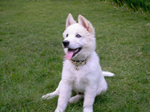
 | Common Nouns | Proper Nouns
 | man | Walt Disney
 | mountain | Mount Everest
 | building | Empire State Building
 | dog | Goofy, Pluto

Slide 6
Concrete and Abstract
Concrete Noun – a noun that you can see, hear, smell, taste, or physically feel
Examples: pen, paper, book, fork, stapler
Abstract Noun – a noun that names an emotion, an idea, or a quality; something that cannot be perceived by the 5 senses
Examples: education, love, patience

Slide 7
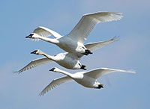
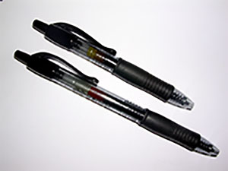
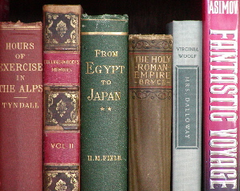
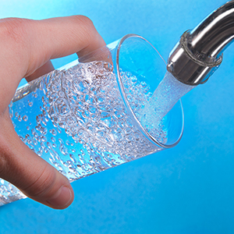
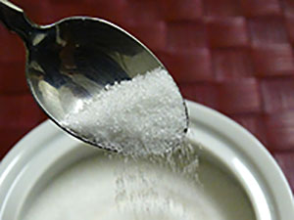
Count and Non-Count
Count Nouns – nouns that you can count
Examples: 3 birds, 2 pens, 6 books
Non-Count Nouns – nouns that you cannot count
Examples: sugar, sand, water

Slide 9
What is a pronoun?
Pronouns – a word that can take the place of a noun
Example: Marie works at David’s school.
She works at his school.
Personal Subject Pronouns – I, you, he, she, it, we , they
Personal Object Pronouns – me, you, him, her, it, us, them
Possessive Pronouns – mine, yours, his ,hers, its, ours, theirs
Demonstrative Pronouns – this, that, these, those

Slide 10
What is a pronoun?
Interrogative Pronouns – who, whom, what, which, whose
Relative Pronouns – who, that, which, whom
Indefinite Pronouns – anybody, somebody, nobody, someone, something, no one, none, each
Reflexive Pronouns – myself, yourself, himself, herself, itself, ourselves, yourselves, themselves
Reciprocal Pronouns – used to identify and action or feeling that is reciprocated: each other, one another

Slide 11
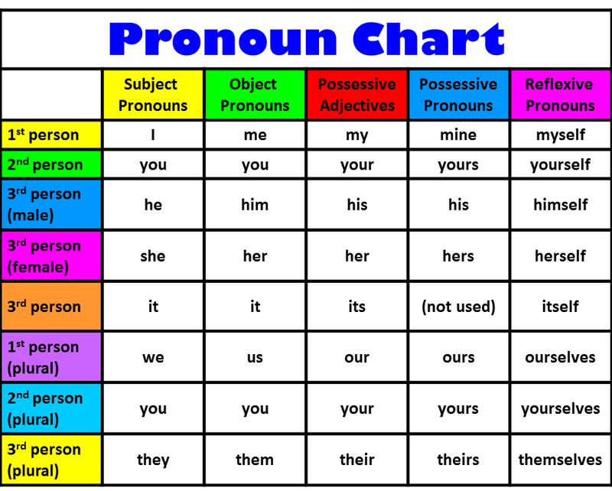

Slide 12
Plural Nouns
REGULAR PLURAL OF NOUNS
1- To make most nouns plural, add -s | an apple two apples a table three tables
2- Nouns ending in:
–sh,-ch,-ss,--x, add -es | a match two matches a class ten classes a dish two dishes a box seven boxes
consonant + y, change the ‘y’ to ‘i’ and add –es. | a baby two babies a library four libraries
vowel +-y, keep the ‘y’ and add –s. | a key five keys a monkey twelve monkeys
‘-f or -fe’, change to ‘v’ and add –es. | a shelf two shelves a knife five knives
‘o’ and add-s, –es or both. | a radio ten radios a tomato two tomatoes a zero two zeros/es.

Slide 13
Plural Nouns
IRREGULAR PLURAL OF NOUNS
Irregular Nouns have irregular plural forms | a child ten children | a mouse nine mice
 | a man three men | a goose five geese
 | a woman four women | a fish ten fish
 | a person ten people | a sheep eight sheep
 | a foot two feet | a tooth two teeth

Slide 14
